Slide 1

Realism in Modeling
October 2024

Slide 2
Introduction
This talk is a small bite out of the expansive world of “Weathering”
What constitutes “weathering” in modeling
Different examples of weathering given material and targets use
Planning
Practical applications
Tools and materials

Slide 3
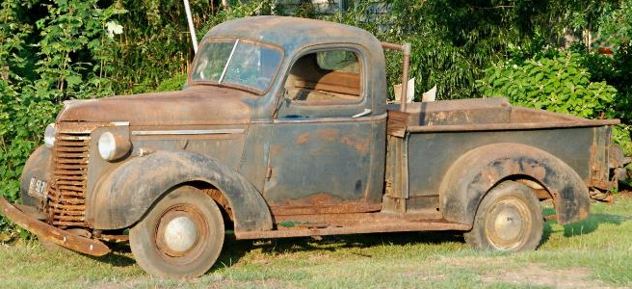
Time, as a Creator
Time, use and the elements create a new appearance and reality of “things”
Vessels are significantly impacted by the elements, their users, and their usage………….more and more over time
ACCUMULATE DUST/DIRT/GREASE
WEAR/SCRATCH/ROUND
DENT
RUST
BREAK/ROT
LOSE PAINT/SHINE

Slide 4
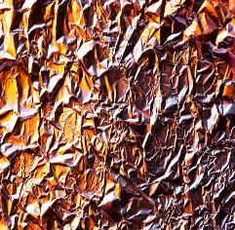
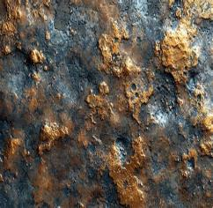
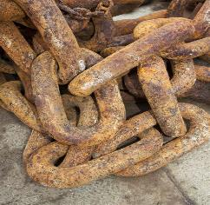
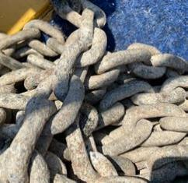
Differences in Aging
Some materials change appearance significantly
Some items of appear differently due to material

Slide 5
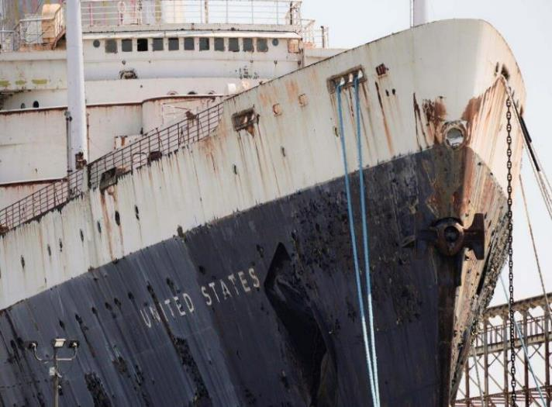
Use of Real-life Examples
Since not all vessels age the same way, find examples of similar vessels to identify location and type of weathering
Expect things like:
  Dirt in corners, around loose items on decks or running down walls
  Oxidized paint: color lightens & shine dims
  Rust around edges and places that water consistently runs
  Oil/grease stains near machinery
This ship shows
Paint fading to different colors on hull
Flaking paint
Surface rust across the upper hull; significant rust below scuppers, rails and other breaks in the bulwarks
Rust appears black on the lower hull
Light coating of gray dirt also present

Slide 6
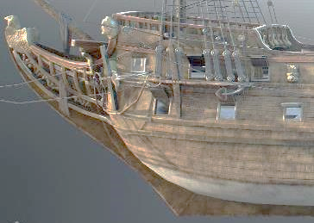
Planning
Plan what age/state (showcase, new-built, battle-tested, past-its-prime, etc.) the model represents
Where does the appropriate aging appear? Don’t overlook usage wear
The crispness of detail will fade with age
Avoid getting carried away. Retain focus
  Tinting, rubbing, fading a small area can tend to carry into a broader application, ruining the effect and causing rework
Was this intended to look like a ship past its prime?

Slide 7
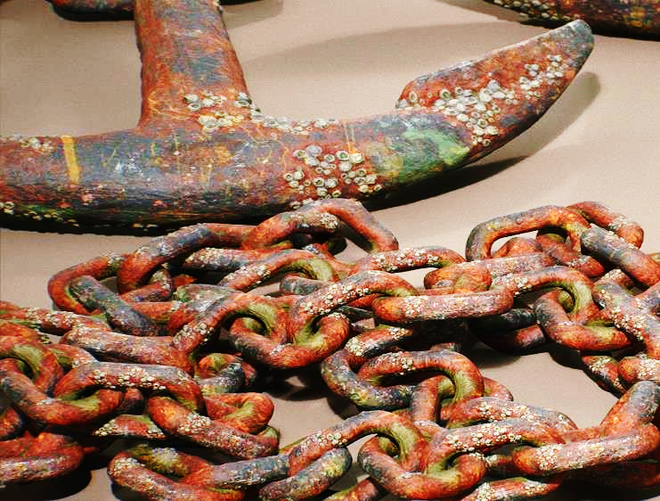
Techniques
Most common weathering tasks are:
  Worn paint
  Rust
  Weathered wood
  Flaking paint
  Aging blocks and cables
Dents, broken windows, missing or broken parts and other affects of aging can be encountered too

Slide 8
Techniques
Colored paint, stains and powders are useful for many weathering effects
Common colors for:
  Rust: barn red to orange
  Dirt: black to brown
  Grease: black
  Copper: Red-0range to turquois
  Bare steel: Varied light gray
Highlights/Emphasis can be achieved with thinned black or dark brown wash

Slide 9
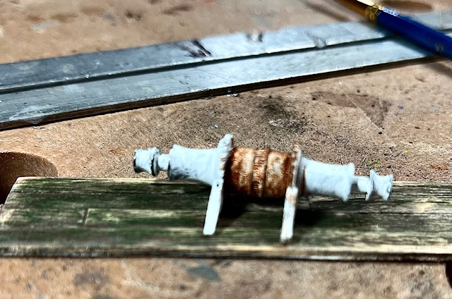
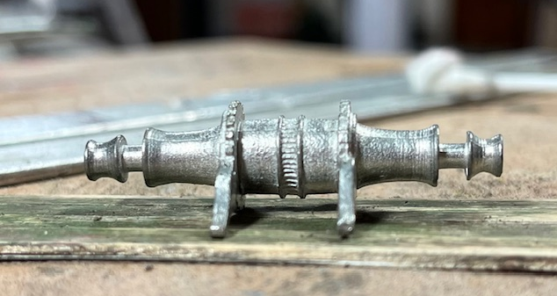
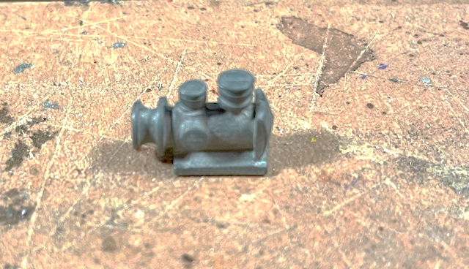
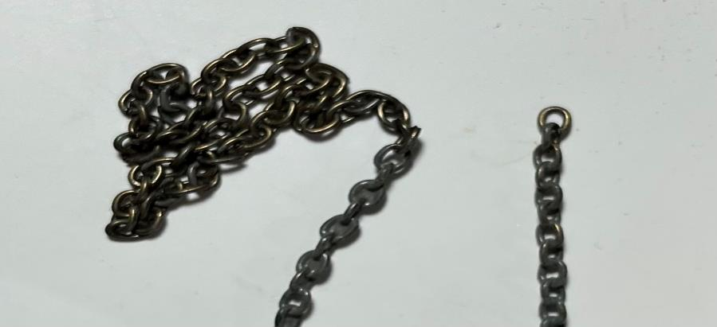
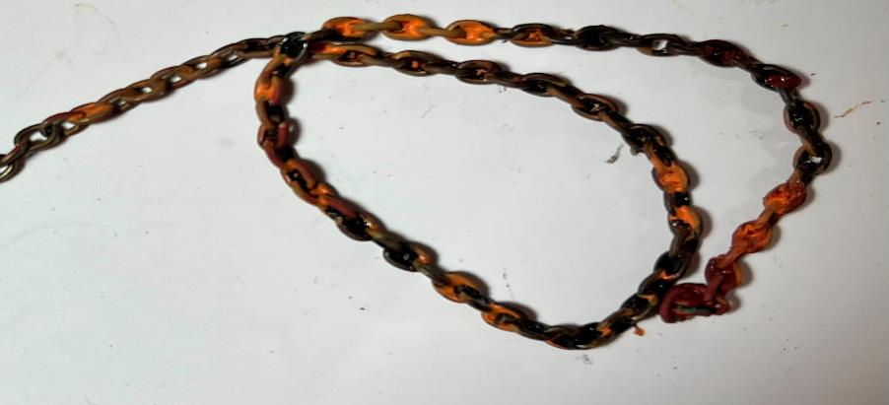
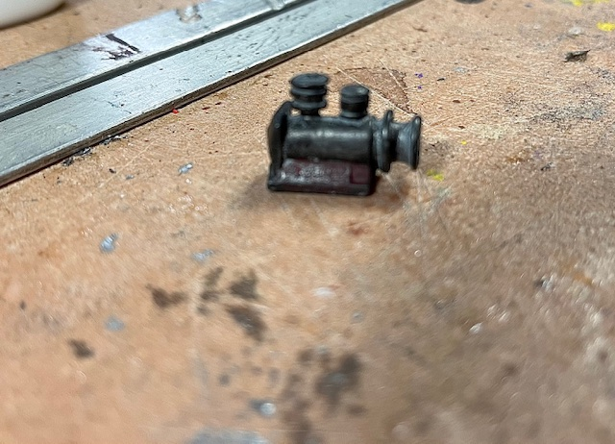
Techniques
Colored base coat acts as primer and enhances look of rust
Combining brown, dark red, orange and black in patches simulates rust
Add turquois, evergreen green and blue for corrosion

Slide 10
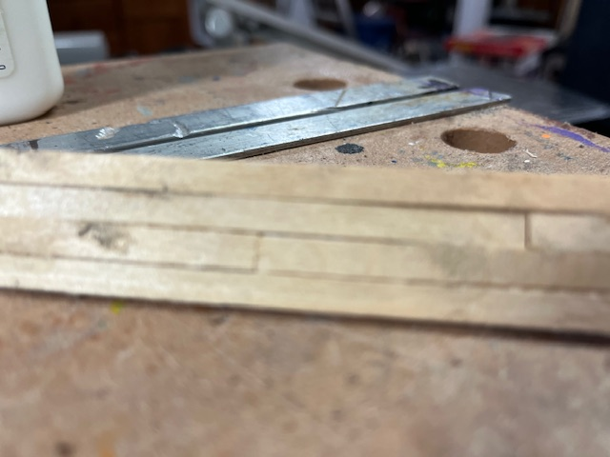
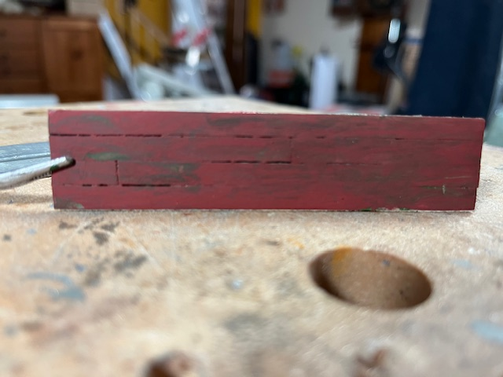
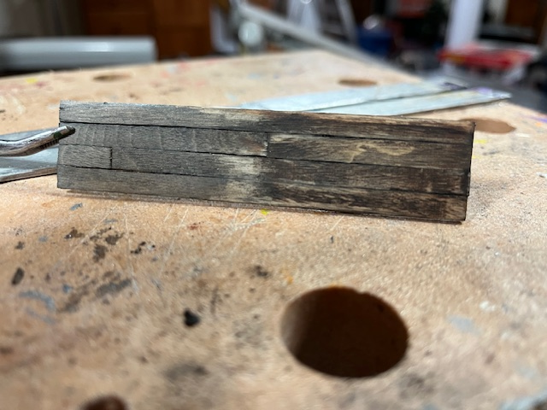
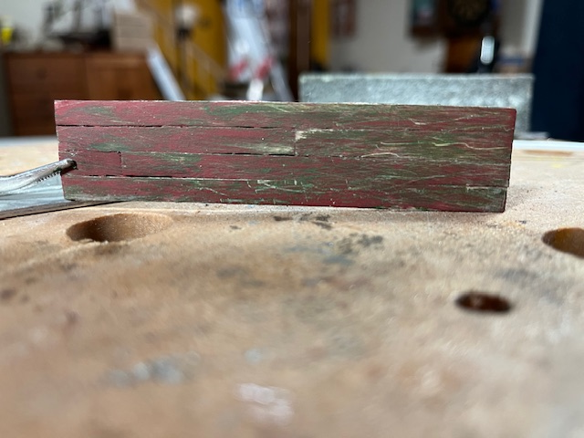
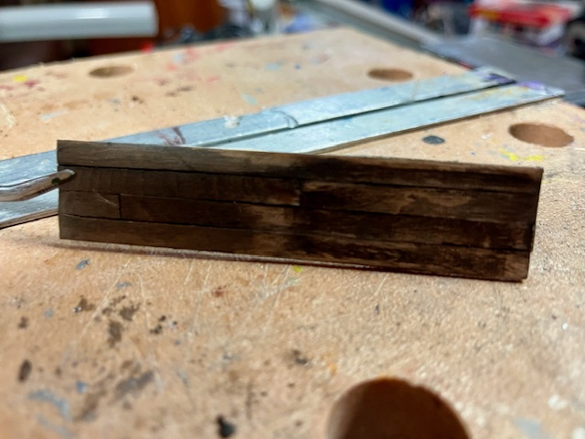
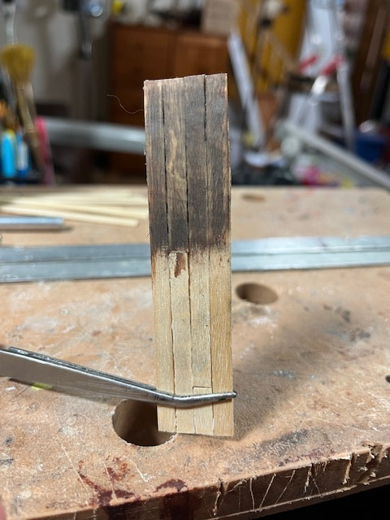
Techniques
Plain Wood
Worn Paint
Gray & Brown Wash
Multi-layer paint
Burnt Cork
Black-wash edges

Slide 11
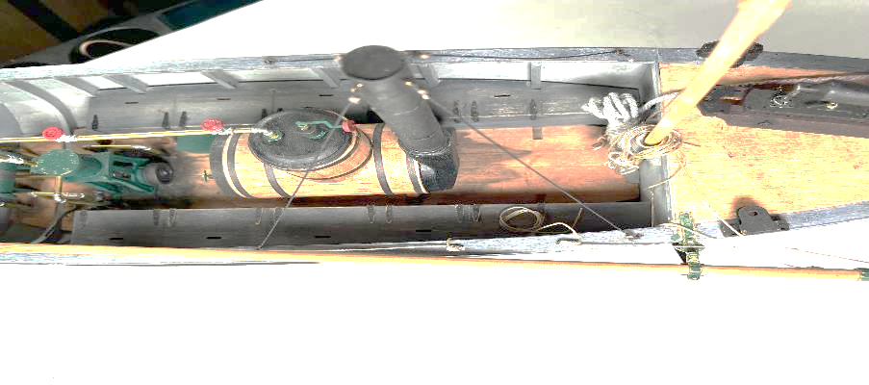
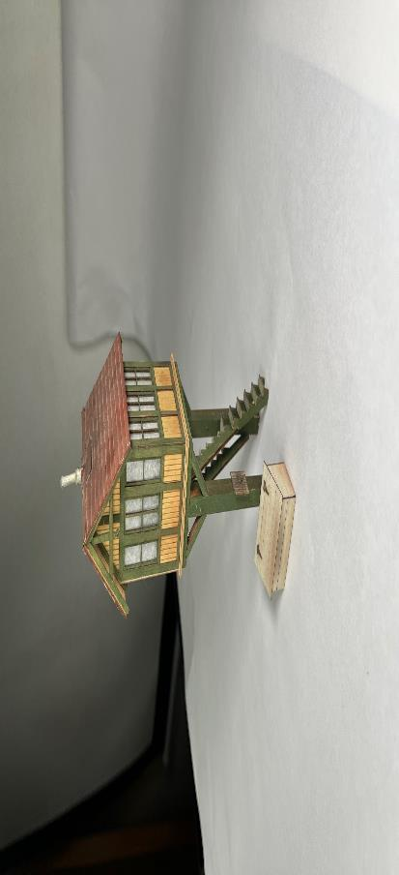
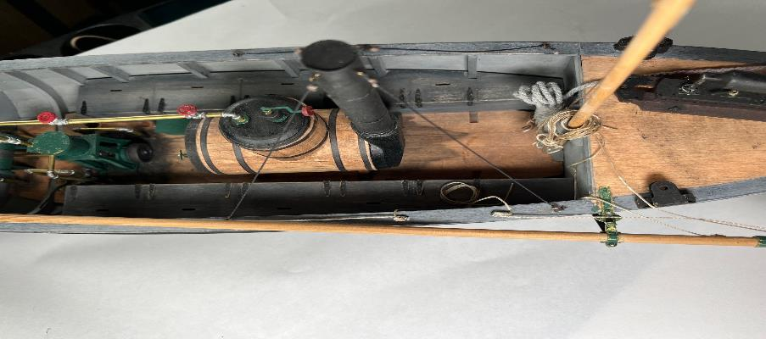
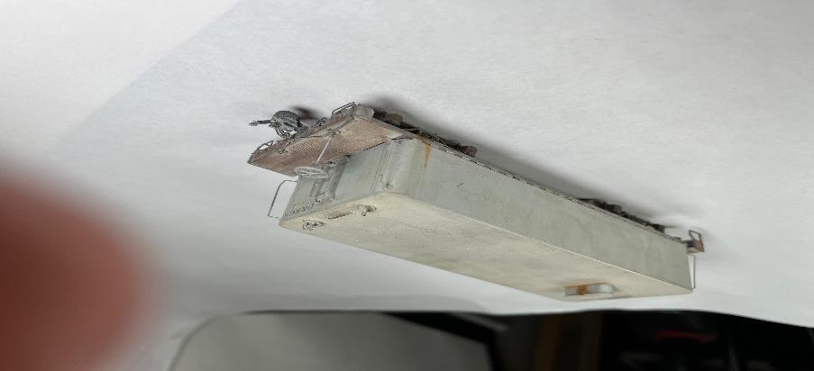
Techniques
Dirt, scrapes, rubs, wear, rust, dust

Slide 12
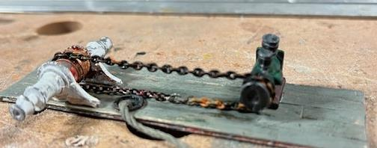
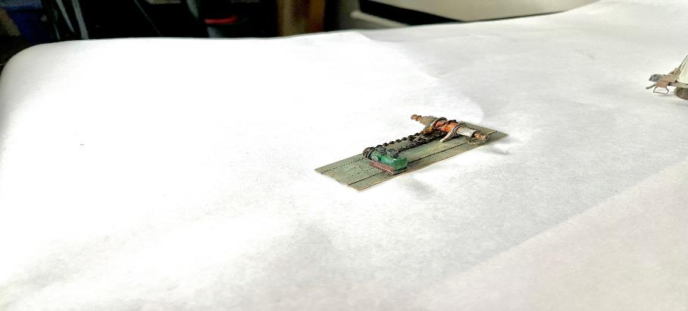
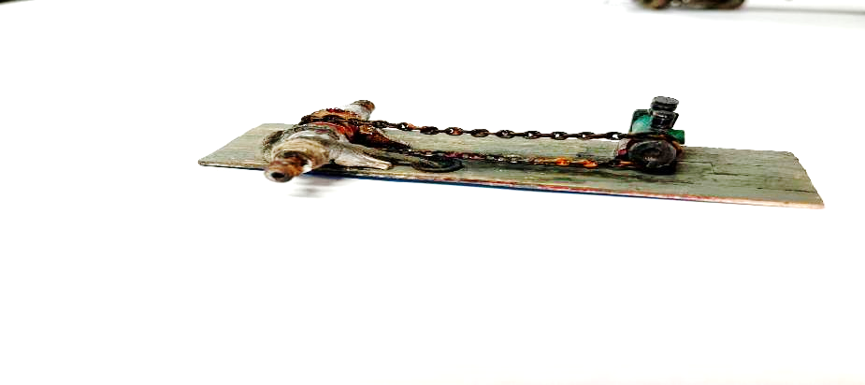
Techniques
Combine pieces, add dirty cable and…………..

Slide 13
Supplies
Materials
  Powder – dust, dirt, smudges, emphasis
  Paint – color variations, age marks, dent & crevice highlights
  Rubber cement – rust patches, stippling
  Abrasives – thinning paint, scratches, wear patches
  Thinners – color variations, plastic stippling/melting
  Tin Foil – crumpled, torn/metal
  Weathering solutions – commercial specialty products
  Vendors: local hobby shops, MicroMark, Model Expo, Michaels, JoAnne Fabrics, Hobbylinc, …
Tools
  Sandpaper
  Scrapers: knives,
  Applicators – disposable brushes, steel wool, sponge
  “Distressers”: small flat or rounded head tools, hammers
  Rotary tool - with brushes and cutters
  Heating tools – blower, irons

Slide 14
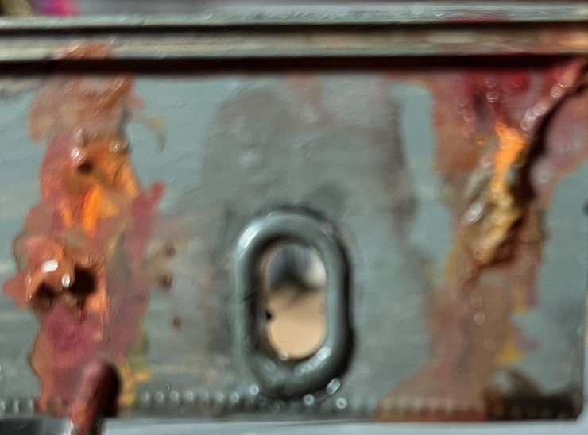
All Stop.
Usually, weathering consists of mimicking rubs or dirt…some sail wear and rope aging
It should be consistent with known examples to maintain authenticity
Common tools and materials are fine
Not always necessary, but can lend character to a model

